Slide 1

Image to Image Translation
Ruben Moreno Aguado
September 7th, 2023

Slide 2
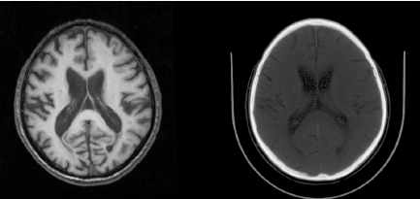
Project Objective
TOTAL SEGMENTATOR
IMAGE-TO-IMAGE TRANSLATION
MODEL

Slide 3
Data sources
Paired Data
😎
rnas/iPromet
- 26694 slices
Unpaired Data
rwork/DATABASES_OPENSOURCE
- 2326459 CT
- 1191895 MR
😭

Slide 4
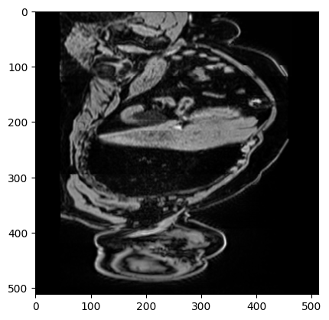
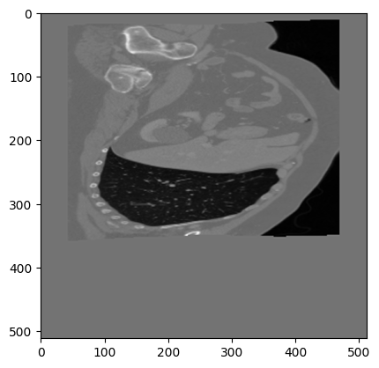
Paired Data
A trivial task!
Less data is available
Registration process deforms the image

Slide 5
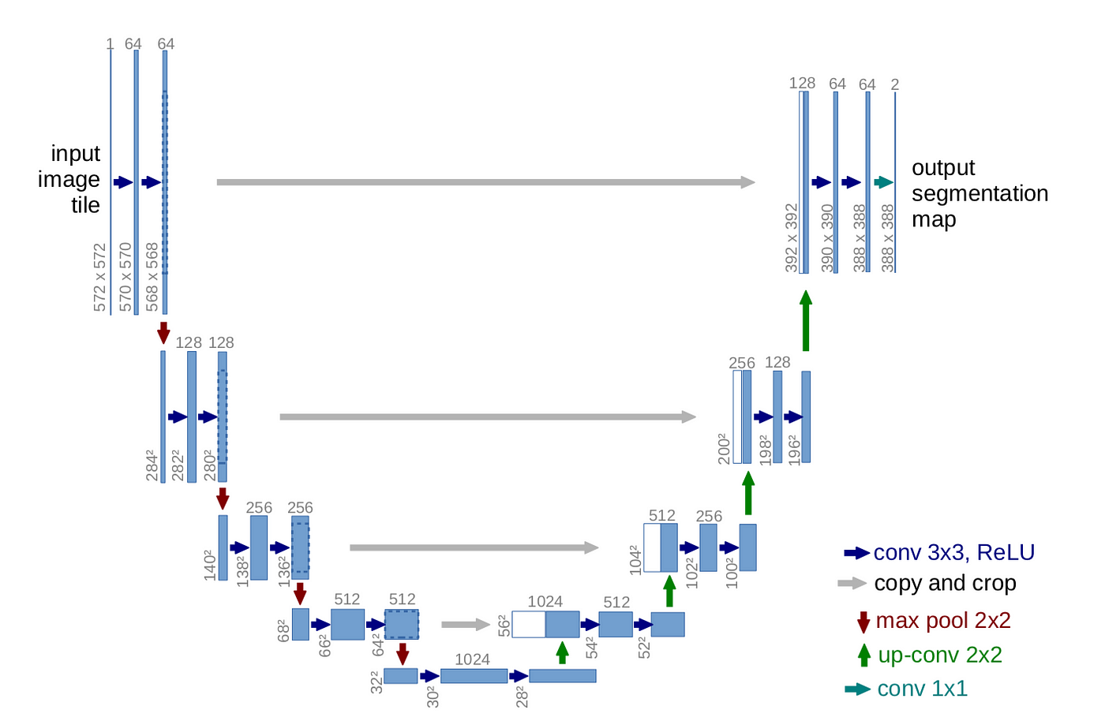
[1]

Slide 6
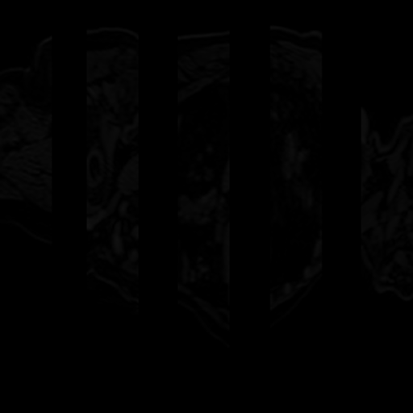
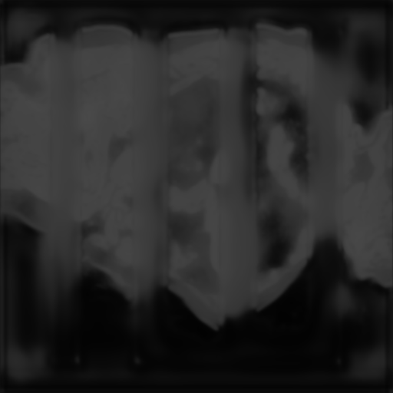
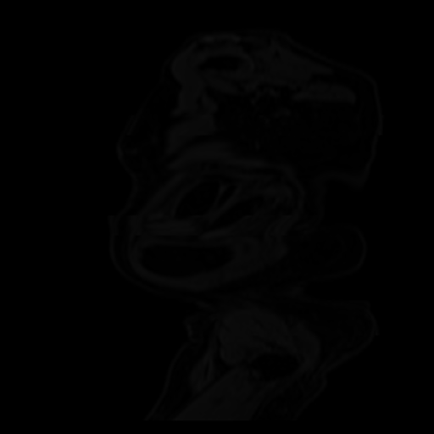
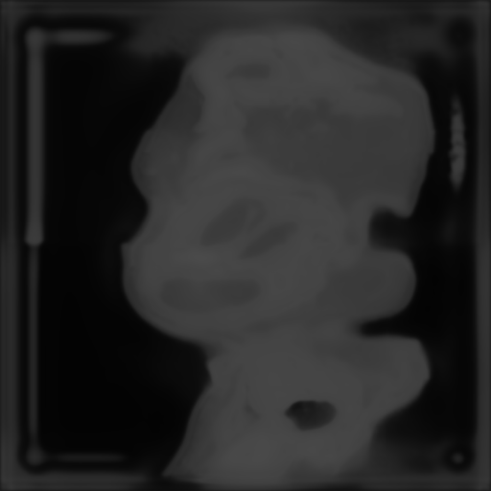
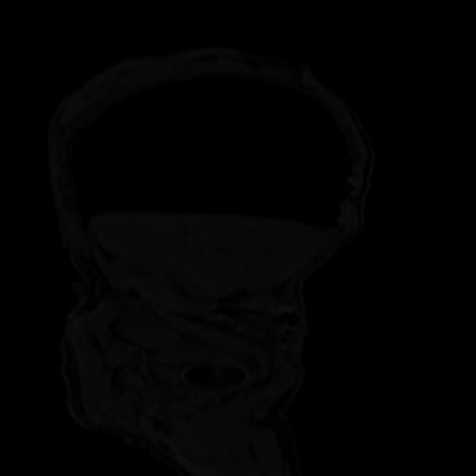
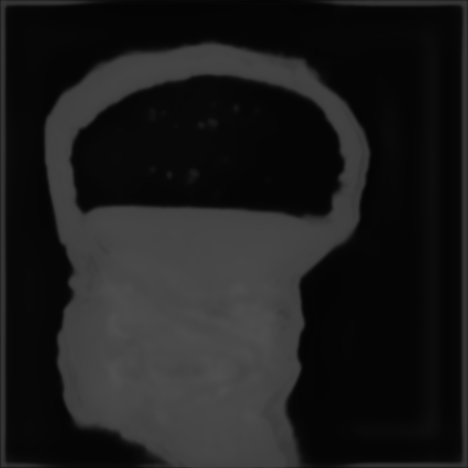
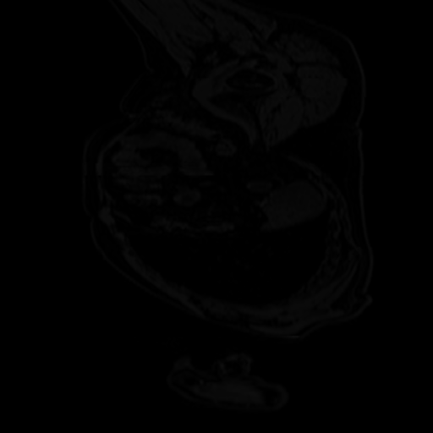
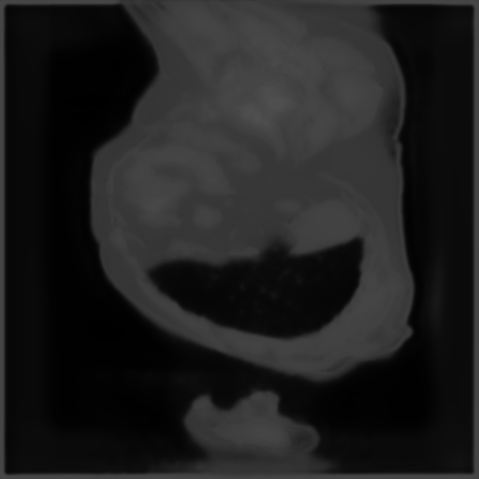

Slide 7
Unpaired Data
Data is abundant
Defining a cost function is difficult
Notes:
Model will have to learn each distribution separately and somehow join them together

Slide 8
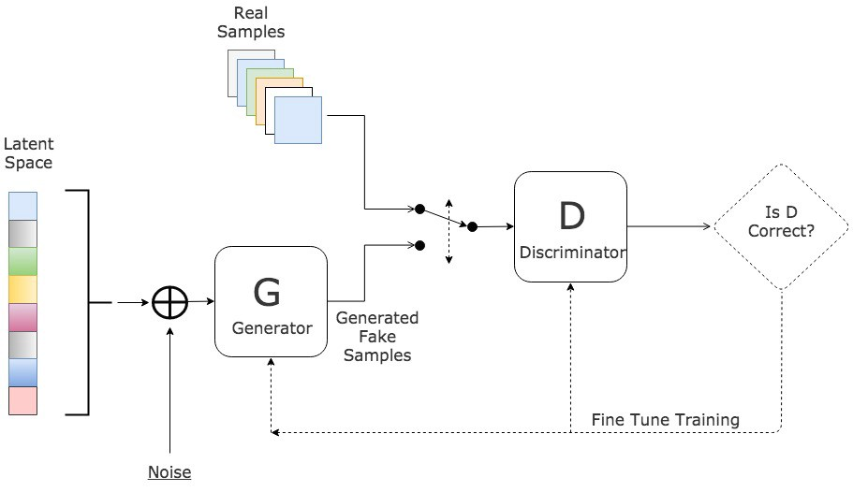
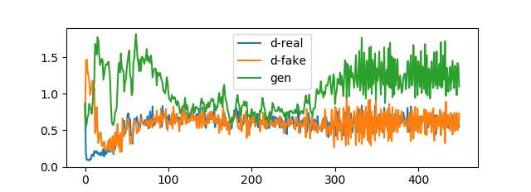
Generative Adversarial Networks
Competing neural networks
Unstable
No metric (in most cases)
Generates good looking images

Slide 9
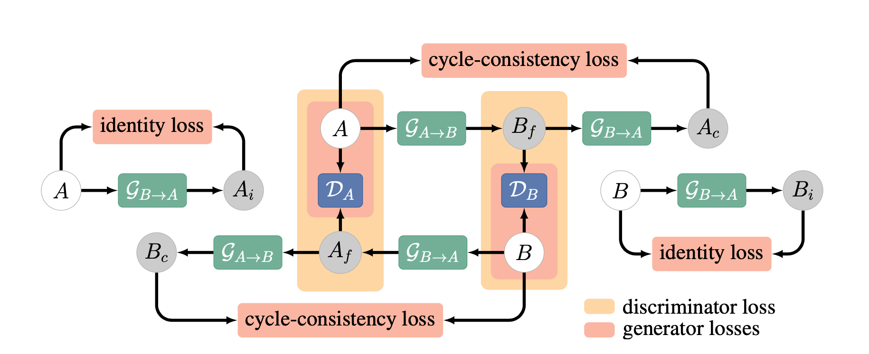
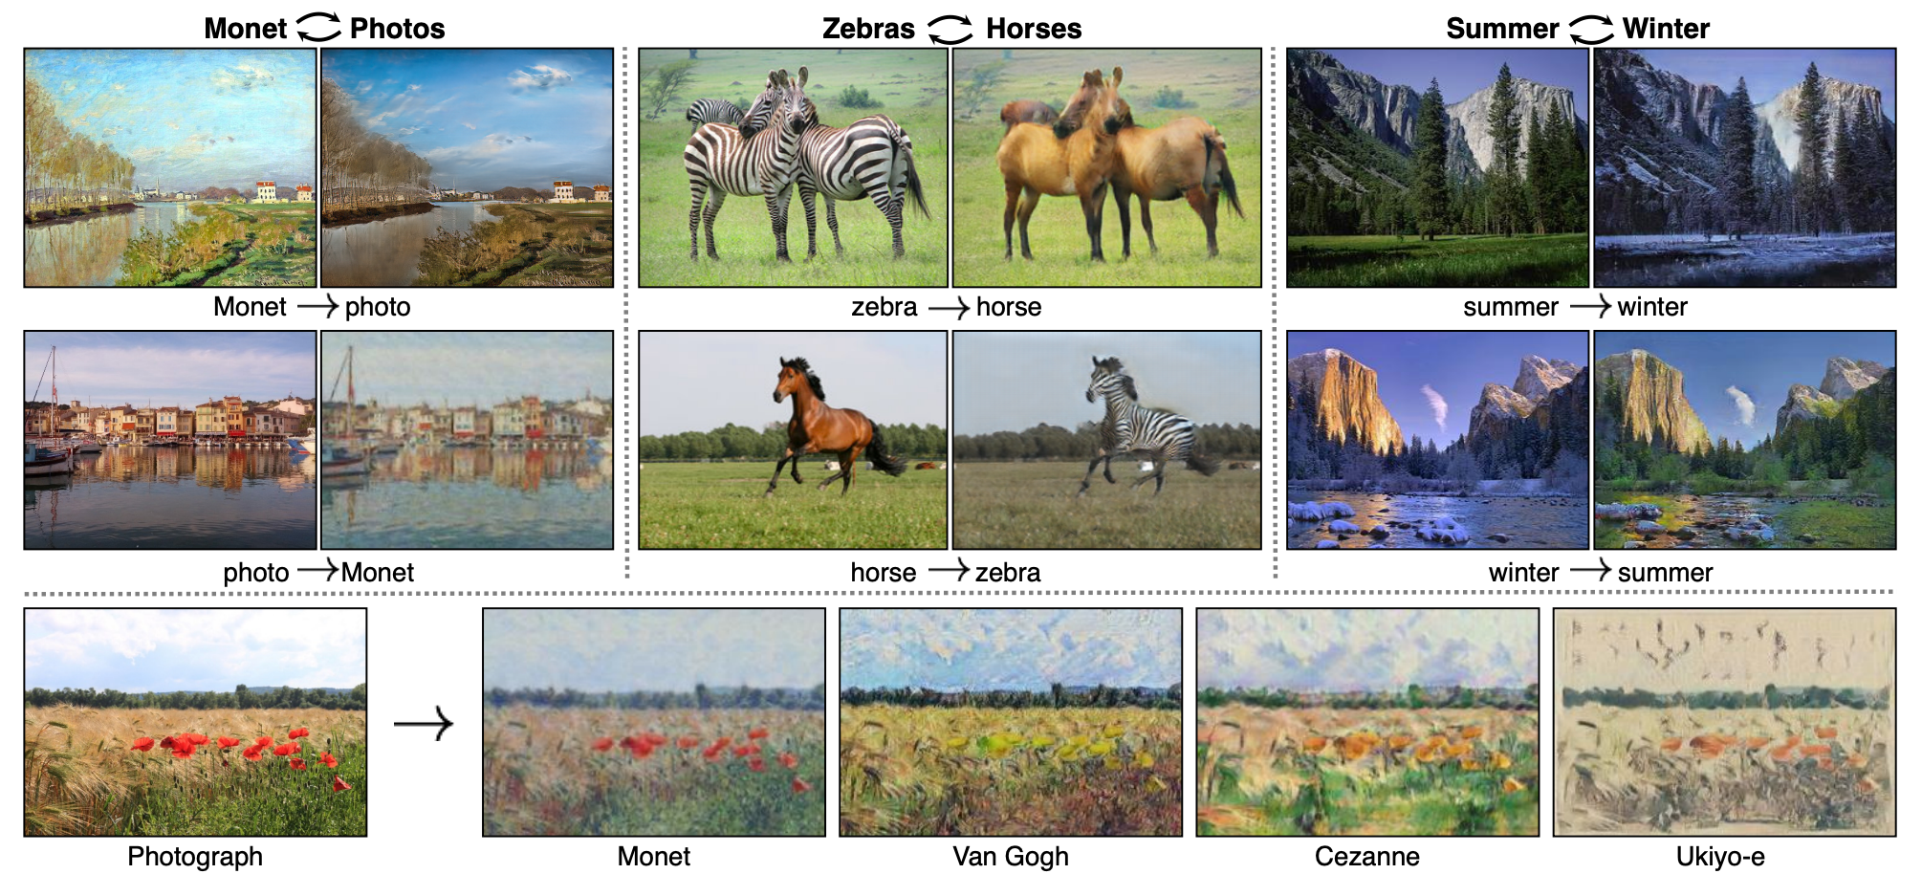
Cyclegan

Slide 10
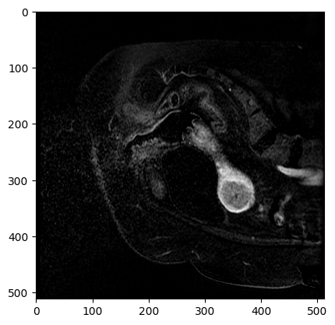
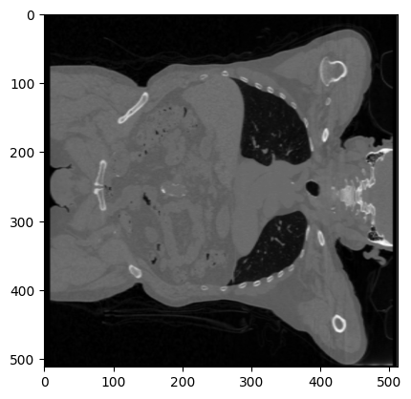
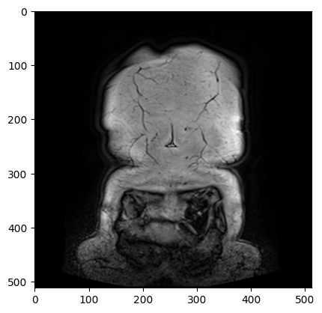
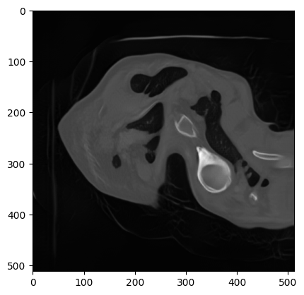
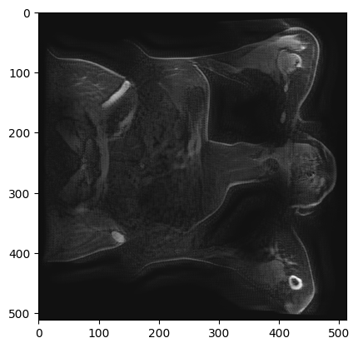
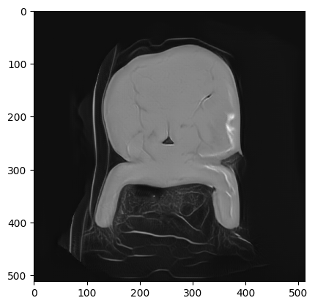

Slide 11
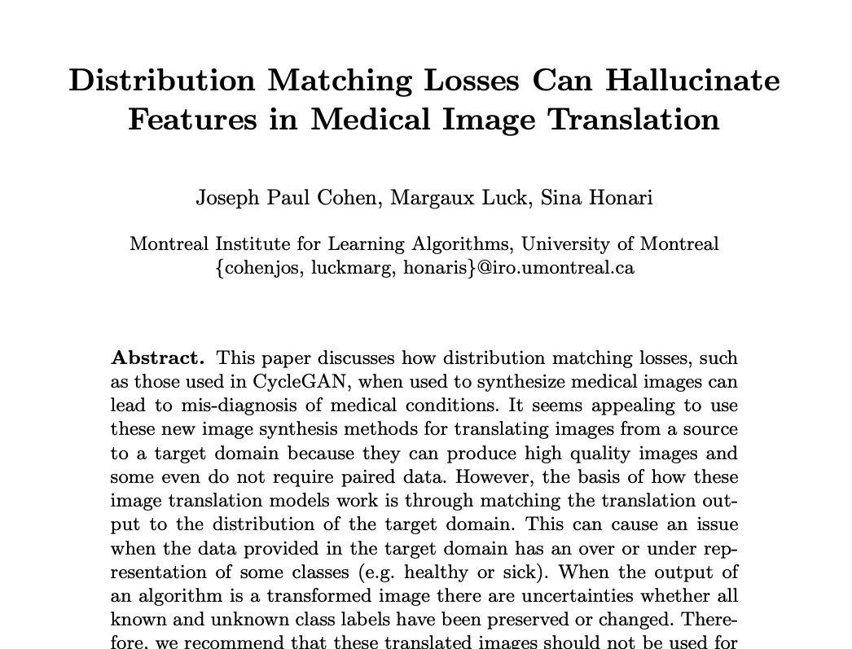
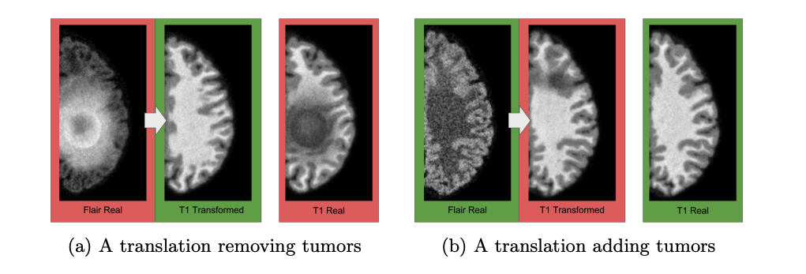
Reliability of GANs for medical data

Slide 13
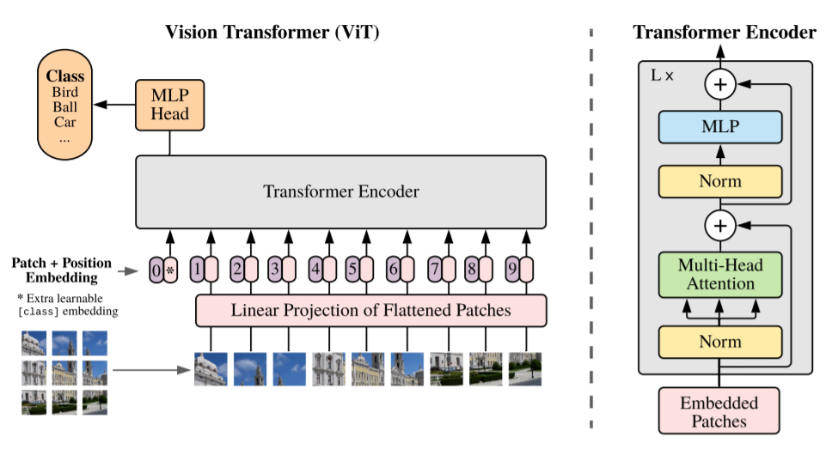
Vision Transformer
Less inductive bias than CNN.
Better performance with more data.
Rarely used for image synthesis.

Slide 14
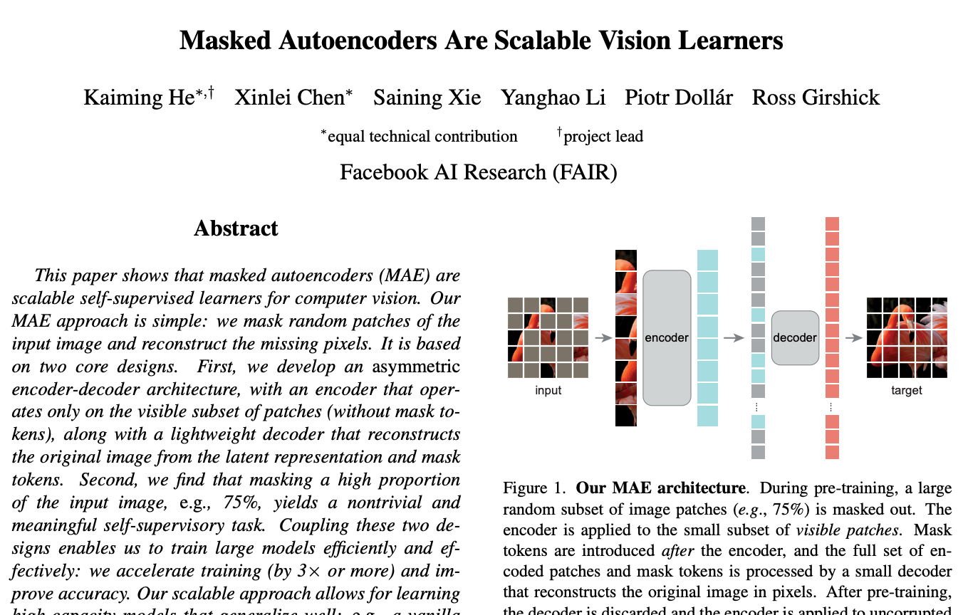
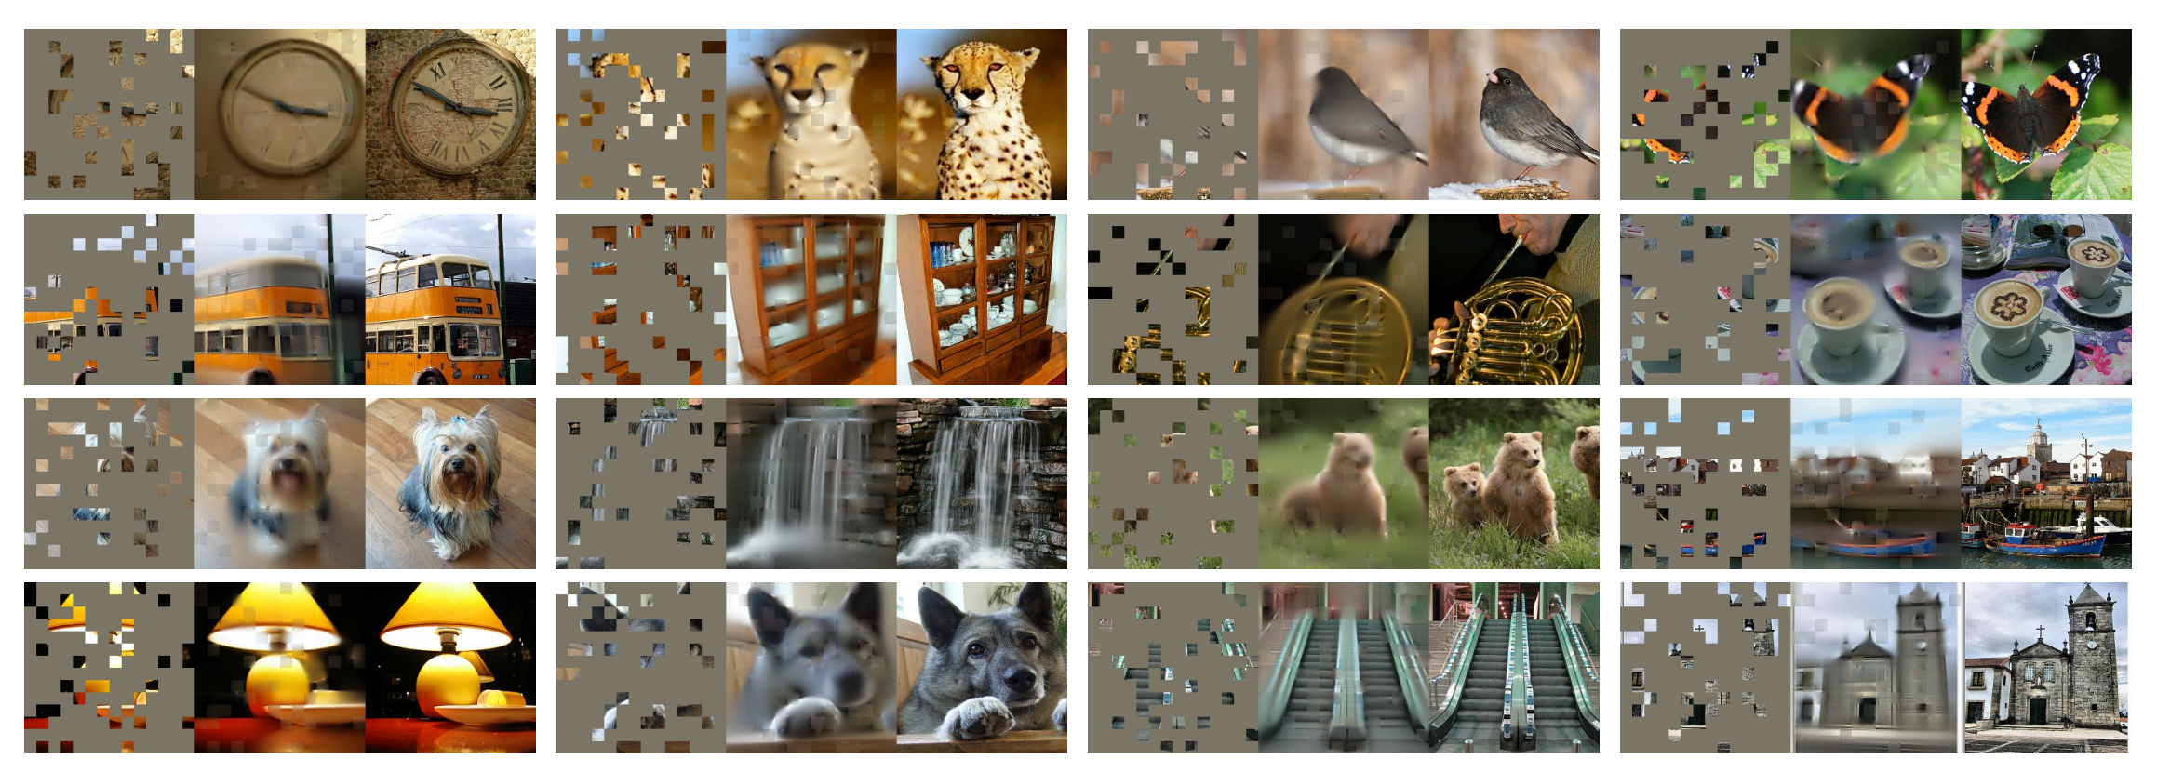
Masked Autoencoder

Slide 15
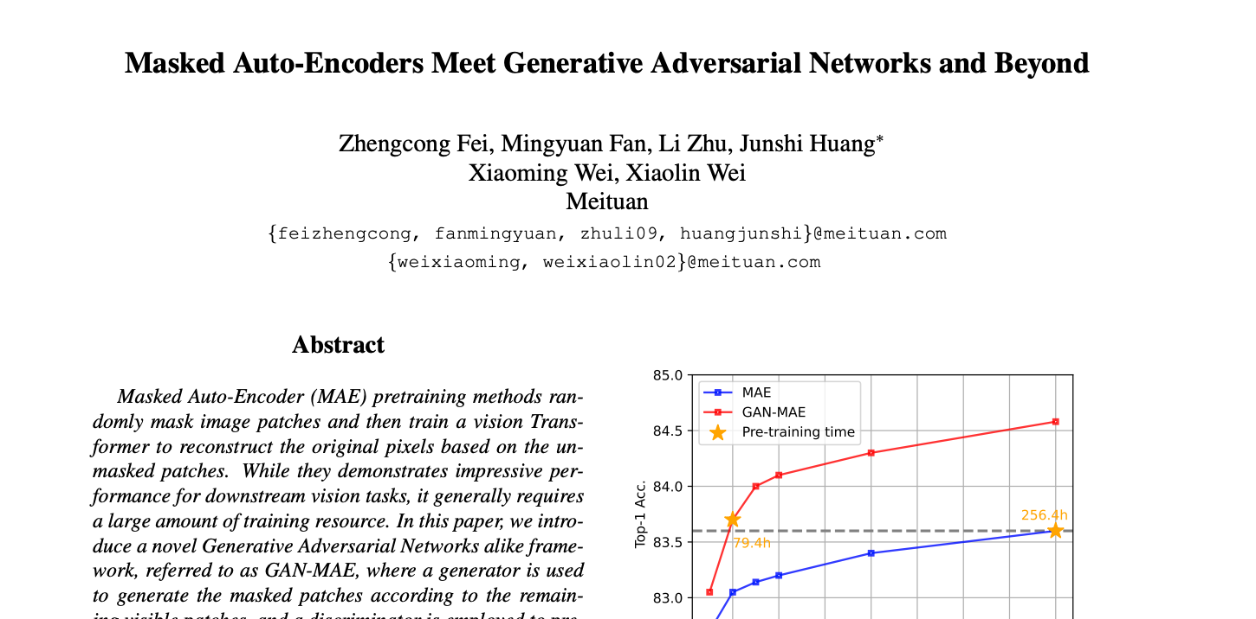
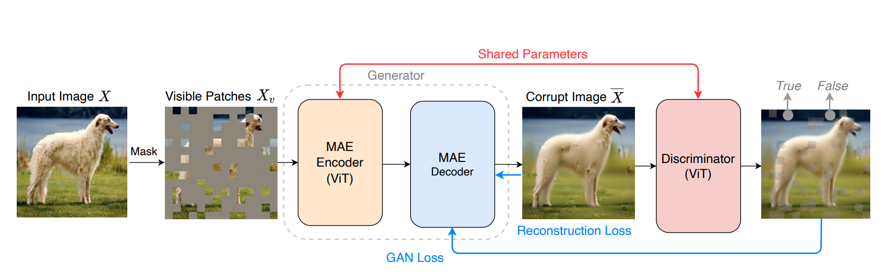
GAN-MAE

Slide 16
Our new design
CT
Decoder
CT
CT
Random
Masking
Encoder
Reconstruction Loss
MR
Decoder
MR
MR
GAN Loss

Slide 17
Our new design
CT
Encoder
Decoder
MR
MR
Cycle Preservation Loss
CT
Decoder
MR
Encoder

Slide 18
References
[1] O. Ronneberger, P. Fischer, and T. Brox, “U-Net: Convolutional Networks for Biomedical Image Segmentation,” Lecture Notes in Computer Science, pp. 234–241, 2015. doi:10.1007/978-3-319-24574-4_28
[2] K. He et al., “Masked autoencoders are scalable vision learners,” 2022 IEEE/CVF Conference on Computer Vision and Pattern Recognition (CVPR), 2022. doi:10.1109/cvpr52688.2022.01553
[1] J.-Y. Zhu, T. Park, P. Isola, and A. A. Efros, “Unpaired image-to-image translation using cycle-consistent adversarial networks,” 2017 IEEE International Conference on Computer Vision (ICCV), 2017. doi:10.1109/iccv.2017.244
[1] I. Goodfellow et al., “Generative adversarial nets,” in Advances in neural information processing systems 27, J. Pouget-Abadie, Ed. NIPS, 2014, pp. 2672–2680

